Slide 1
WWW.MINEPORTAL.IN
ONLINE TEST SERIES FOR
DGMS COAL/METAL FIRST/SECOND CLASS EXAM
GATE MINING EXAM
OVERMAN EXAM TEST
MINING INSPECTOR EXAMS
COAL INDIA MTS & OTHER PSUS EXAMS
FREE STUDY MATERIAL & VIDEO LECTURES
MINING JOBS NOTIFICATIONS
WWW.MINEPORTAL.IN CALL/WHATSAPP-8804777500 WWW.FB.COM/MINEPORTAL.IN

Slide 2
CENTRIFUGAL PUMPS & TURBINES

Slide 3
CENTRIFUGAL PUMPS
A MACHINE FOR MOVING FLUID BY ACCELERATING THE FLUID RADIALLY OUTWARD.
From the Center
of a Circle
RADIAL DIRECTION
To the Outside of a Circle

Slide 4
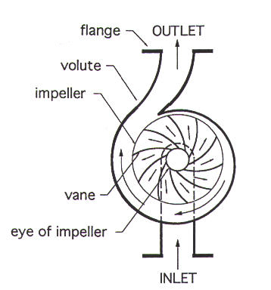
TERMINOLOGY
A COLLECTION CHAMBER IN THE CASING CONVERTS MUCH OF THE KINETIC ENERGY (ENERGY DUE TO VELOCITY) INTO HEAD OR PRESSURE.

Slide 5
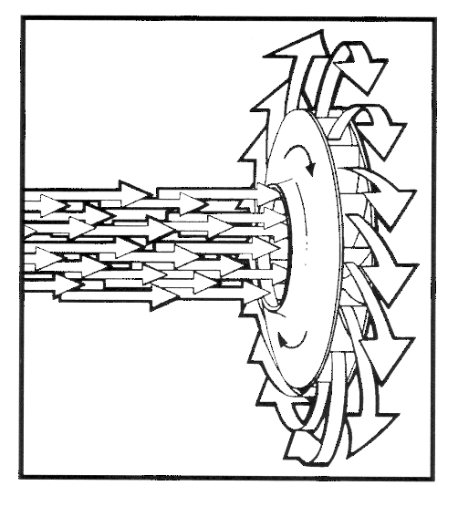
CENTRIFUGAL PUMPS
THIS MACHINE CONSISTS OF AN IMPELLER ROTATING WITHIN A VOLUTE CASE (DIFFUSER)
LIQUID DIRECTED INTO THE
CENTER OF THE ROTATING
IMPELLER IS PICKED UP BY
THE IMPELLER’S VANES AND
ACCELERATED TO A HIGHER VELOCITY BY THE ROTATION OF THE IMPELLER AND DISCHARGED BY CENTRIFUGAL FORCE INTO THE CASE (DIFFUSER).

Slide 6
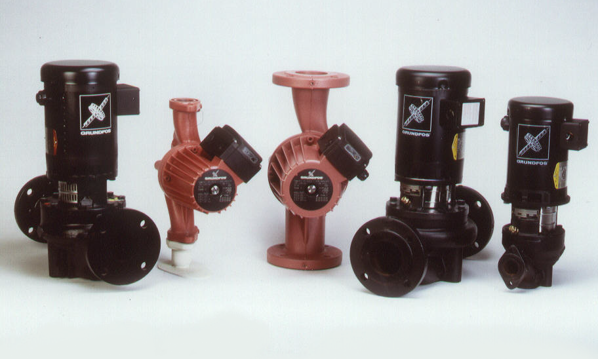
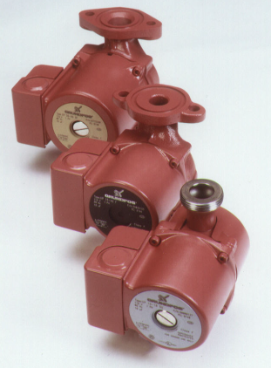
Pump Basics

Slide 7
"HEAD"
HEAD IS A TERM FOR EXPRESSING FEET OF WATER COLUMN
HEAD CAN ALSO BE CONVERTED TO PRESSURE
Reservoir of Fluid
100 feet
43.3 PSI
Pressure
Gauge

Slide 8
CALCULATION OF HEAD DEVELOPED IN A PUMP:
HEAD (FEET OF LIQUID) =PRESSURE IN PSI X 2.31 / SP. GR.
PRESSURE IN PSI = HEAD (IN FEET) X SP. GR. / 2.31
PSI IS POUNDS PER SQUARE INCH
SP. GR. IS SPECIFIC GRAVITY WHICH FOR WATER IS EQUAL TO 1
  FOR A FLUID MORE DENSE THAN WATER, SP. GR. IS GREATER THAN 1
  FOR A FLUID LESS DENSE THAN WATER, SP. GR. IS LESS THAN 1

Slide 9
HEAD
HEAD AND PRESSURE ARE INTERCHANGEABLE TERMS PROVIDED THAT THEY ARE EXPRESSED IN THEIR CORRECT UNITS.
THE CONVERSION OF ALL PRESSURE TERMS INTO UNITS OF EQUIVALENT HEAD SIMPLIFIES MOST PUMP CALCULATIONS.

Slide 10

CENTRIFUGAL IMPELLERS
Impeller
Vanes
“Eye of the Impeller”
Water Entrance
Thickness
of the impeller
Diameter of
the Impeller
THICKER THE IMPELLER- MORE WATER
LARGER THE DIAMETER - MORE PRESSURE
INCREASE THE SPEED - MORE WATER AND PRESSURE

Slide 11
TWO IMPELLERS IN SERIES
Direction of Flow
TWICE THE PRESSURE
SAME AMOUNT OF WATER

Slide 12
MULTIPLE IMPELLERS IN SERIES
Direction of Flow
Direction of Flow
PLACING IMPELLERS IN SERIES INCREASES THE AMOUNT OF HEAD PRODUCED
THE HEAD PRODUCED = # OF IMPELLERS X HEAD OF ONE IMPELLER

Slide 13
WORKING OF PUMPS DEPENDS ON FOLLOWING LIQUID PROPERTIES:
LIQUID FIND THEIR OWN LEVEL
A LIQUID IS ALMOST INCOMPRESSIBLE IN CONTRAST TO GAS.
AT ANY POINT IN A LIQUID PRESSURE ACTS EQUALLY IN ALL DIRECTIONS AND IS SAME AT SAME LEVELS IN A LIQUID AT REST.
PRESSURE PER UNIT AREA VARIES DIRECTLY AS THE HEAD.
WORKING OF PUMPS DEPENDS ON ARCHIMEDES PRINCIPLE AND BERNOULLI’S THEOREM.

Slide 14
CONSTRUCTION OF A TURBINE PUMP:
A TURBINE PUMPS CONSISTS OF:
NUMBER OF IMPELLERS MOUNTED ON ONE SHAFT.
A STATIONARY SPIRAL OR VOLUTE CASING.
SUCTION PIPE CONNECTED TO FLANGE.
DELIVERY PIPE CONNECTED TO FLANGE.
DIFFUSER
BALANCER
THERE ARE 2 TYPES OF PUMPS:
SINGLE INLET PUMP
DOUBLE INLET PUMP

Slide 15
DIFFERENCE BETWEEN WORKING OF TURBINE AND CENTRIFUGAL PUMPS
TURBINE PUMP DIFFERS FROM THE CENTRIFUGAL PUMP IN THAT THE FORMER CONSISTS OF A NUMBER OF IMPELLERS MOUNTED ON ONE SHAFT AND THE WATER OF EACH IMPELLER ENTERS STATIONARY DIFFUSING CHANNELS OF THE DIFFUSER SURROUNDING THE IMPELLER.
WATER ENTERS THE IMPELLER NEAREST TO THE SUCTION PIPE, IS CARRIED BY THE ROTATING IMPELLER TO THE PERIPHERY AT A HIGH SPEED AND IS CONVERTED TO HIGH PRESSURE AND LOW SPEED AT THE END OF THE DIFFUSER.
WATER THEN ENTERS THE NEXT IMPELLER AT A HIGH PRESSURE AND LOW VELOCITY TO UNDERGO SIMILAR PROCESS FURTHER INCREASING PRESSURE AND LOWERING THE VELOCITY FURTHER.
THE PROCESS CONTINUES TILL WATER ENTERS THE DELIVERY PIPE WITH A HIGH PRESSURE BUT ONLY A LITTLE VELOCITY.

Slide 16
EACH IMPELLER WITH THE DIFFUSER CONSISTS ONE STAGE AND THE HEAD DEVELOPED PER STAGE VARIED FORM 15-50 M DEPENDING UPON
DIAMETER AND SPEED OF IMPELLER
CURVATURE OF IMPELLER
DESIGN OF DIFFUSER
A TURBINE PUMP CARRIES A BALANCING DISC WHICH IS NOT PROVIDED ON CENTRIFUGAL PUMP. THE NUMBER OF IMPELLERS ON SHAFT DOES NOT EXCEED 10 IN ORDER TO PREVENT BENDING AND TO REDUCE THE LENGTH.

Slide 17
BALANCING OF AXIAL THRUST
IN CASE OF SINGLE INLET IMPELLERS, A CONSIDERABLE END THRUST IS DEVELOPED WHICH ACTS TOWARDS THE SUCTION END OF THE PUMP. THE AXIAL END-THRUST OCCURS BECAUSE WATER UNDER PRESSURE LEAKS INTO THE CLEARANCE SPACES ON BOTH SIDES OF EACH IMPELLER, BETWEEN THE IMPELLER AND ITS ENCLOSING DIAPHRAGMS.
TOTAL THRUST=DIFFERNECE OF 2 AREAS*PRESSURE PER UNIT AREA IN CLEARENCE SPACE*NUMBER OF IMPELLERS

Slide 18
COUNTERING OF AXIAL THRUST
AXIAL THRUST CAN BE COUNTERED IN THE FOLLOWING WAYS:
IN CASE OF A SINGLE STAGE CENTRIFUGAL PUMP BY USING A DOUBLE ENTRY IMPELLER
IN CASE OF A DOUBLE STAGE CENTRIFUGAL PUMP BY PLACING THE IMPELLERS BACK TO BACK.
BY USE OF A THRUST BEARING
BY USE OF A BALANCER DISC.

Slide 19
LAWS OF CENTRIFUGAL OR TURBINE PUMP:
QUANTITY OF WATER DELIVERED BY A GIVEN PUMP VARIES DIRECTLY AS THE PERIPHERAL SPEED OR RPM OF IMPELLER
PRESSURE VARIES AS SQUARE OF SPEED
POWER REQUIRED VARIES AS PRODUCT OF PRESSURE AND QUANTITY AND HENCE VARIES AS CUBE OF PERIPHERAL VELOCITY.
Q=K*V
P=K*V^2
POWER=K*V^3

Slide 20
PUMP PERFORMANCE CURVE
A MAPPING OR GRAPHING OF THE PUMP'S ABILITY TO PRODUCE HEAD AND FLOW

Slide 21
PUMP PERFORMANCE CURVE
Performance Curve
MOST PUMP PERFORMANCE CURVES SLOPE FROM LEFT TO RIGHT
Head
Pump Flow Rate

Slide 22
PUMP PERFORMANCE CURVE
IMPORTANT POINTS
Shut-off Head
SHUT-OFF HEAD IS THE MAXIMUM PRESSURE OR HEAD THE PUMP CAN PRODUCE
NO FLOW IS PRODUCED
Head
Pump Flow Rate

Slide 23
PUMP PERFORMANCE CURVE
IMPORTANT POINTS
Maximum Flow
MAXIMUM FLOW IS THE
LARGEST FLOW THE PUMP CAN
PRODUCE
NO HEAD IS PRODUCED
Head
Pump Flow Rate

Slide 24
SYSTEM PERFORMANCE CURVES
SYSTEM PERFORMANCE CURVE IS A MAPPING OF THE HEAD REQUIRED TO PRODUCE FLOW IN A GIVEN SYSTEM
A SYSTEM INCLUDES ALL THE PIPE, FITTINGS AND DEVICES THE FLUID MUST FLOW THROUGH, AND REPRESENTS THE FRICTION LOSS THE FLUID EXPERIENCES

Slide 25
SYSTEM PERFORMANCE CURVE
THE FRICTION LOSS IS MAPPED ONTO THE GRAPH
THE AMOUNT OF FRICTION LOSS VARIES WITH FLOW THROUGH THE SYSTEM
Friction Loss
Head
Pump Flow Rate

Slide 26
The point on the system curve that intersects the pump curve is known as the operating point.
Head
Pump Flow Rate

Slide 27
QUESTIONS???

